Slide 1

Image Generation
Using Generative Adversarial Nets
Rajat Sawant
TE1 3168 Seminar Guide: Prof. S.N. Reddy

Slide 2
Problem Statement
Generating Photo-realistic images using Generative Adversarial network with text descriptions and image dataset as input.

Slide 3
Motivation
A human condition called Synesthesia, where simulation of one cognitive pathway leads to experiences in a second cognitive pathway.
Previous Methods : PixelRNN and PixelCNN
Image generation based on the other format of data like other images( image to image) or from text descriptions (text to image) have large number of applications in various sectors.

Slide 4
Introduction
Generative adversarial networks (GANs) : Deep neural net architectures comprised of two nets, pitting one against the other,thus called adversarial. Generative adversarial networks have demonstrated that it is possible to create fake but photo realistic images after training on an image dataset.
Text descriptions to image:
Use of StackGAN:
Converts the problem of image generation into more manageable sub-problems.
Task of stage I and stage II GAN

Slide 5
Literature Survey
Sr. No. | Title | Author | Description | Findings
1. | “Generative Adversarial Nets” | Ian J. Goodfellow, Jean Pouget-Abadie, Mehdi Mirza, Bing Xu, David Warde-Farley, Sherjil Ozair, Aaron Courville, Yoshua Bengio | Paper introduces briefly about GANs,their architecture, algorithm for minibatch stochastic gradient descent training of GAN | GANs provide a method to generate the fake data similar to what is present in the dataset. Hence data in various formats like audio, images, text can be generated using GANs. GANs require high computational power for training

Slide 6
Literature Survey
Sr. No. | Title | Author | Description | Findings
2. | “StackGAN: Text to Photo-realistic Image Synthesis with Stacked Generative Adversarial Networks” | Han Zhang, Tao Xu, Hongsheng Li, Shaoting Zhang, Xiaogang Wang, Xiaolei Huang, Dimitris Metaxas | The paper describes method to generate high quality images from text descriptions | Using two GANs stacked together produces better quality images. First stage GAN produces primitive shapes and color based on text descriptions while second stage generates high resolution images.

Slide 7
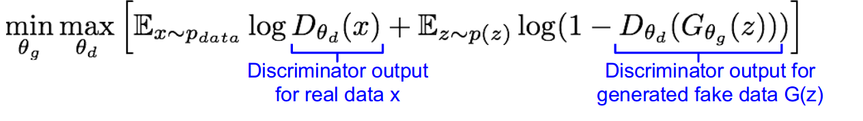
Generative Adversarial Network
Consists of two networks Generator G and discriminator D pitting against one another. Framework corresponds to a two-player minimax game.
Generator Network : Try to fool the discriminator by generating real-looking images
Discriminator Network : Try to distinguish between real and fake images. Discriminator outputs likelihood in (0,1) of real image.
The minimax objective function is :

Slide 8
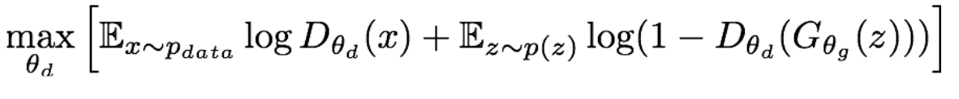
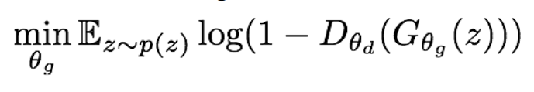
Generative Adversarial Network
Discriminator wants to maximize objective such that D(x) is close to 1 i.e. real and D(G(z)) is close to zero (fake).
Generator wants to minimize objective such that D(G(z)) is close to 1 so that it generates output which was indistinguishable by the discriminator from real data.
Hence GANs work in alternate mode between:
Gradient ascent on discriminator
Gradient descent on generator

Slide 9
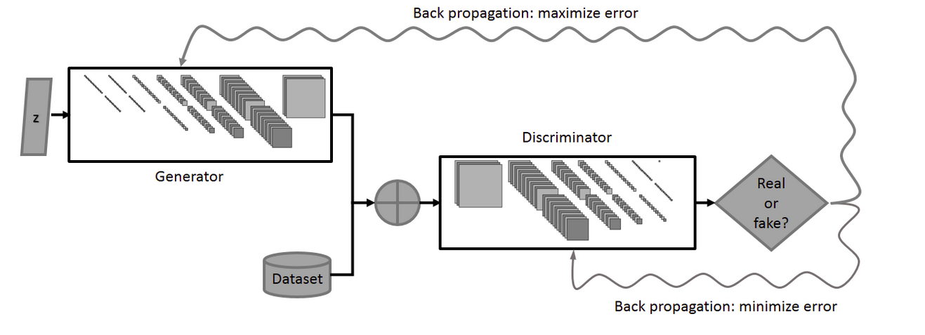
Generative Adversarial Network

Slide 10
Algorithm used to train GAN
For number of training iterations do:
For k steps do:
Create noise sample p(z)
Create data distribution from real data p(x)
Update the discriminator by updating weights
Give noise sample to generator for image generation
Update the weights of generator

Slide 11
Image generation using StackGAN
Task of two stages in StackGAN :
Stage-I GAN: It sketches the primitive shape and basic colors of the object conditioned on the given text description, and draws the background layout from a random noise vector producing a low-resolution image.
Stage-II GAN: It takes the output of Stage -I GAN and text embeddings t work on more details based on the text description of object.
Input text is encoded using an encoder and generates text embeddings which maps the given text to a vectors with dimensions >100 in our case.
The conditioning variable is created based on this text embeddings creates a condition for the stage I generator.
The output from Stage I GAN is fed to stage II GAN rather than processing on a random noise. The text embeddings are also fed to stage II GAN.

Slide 12
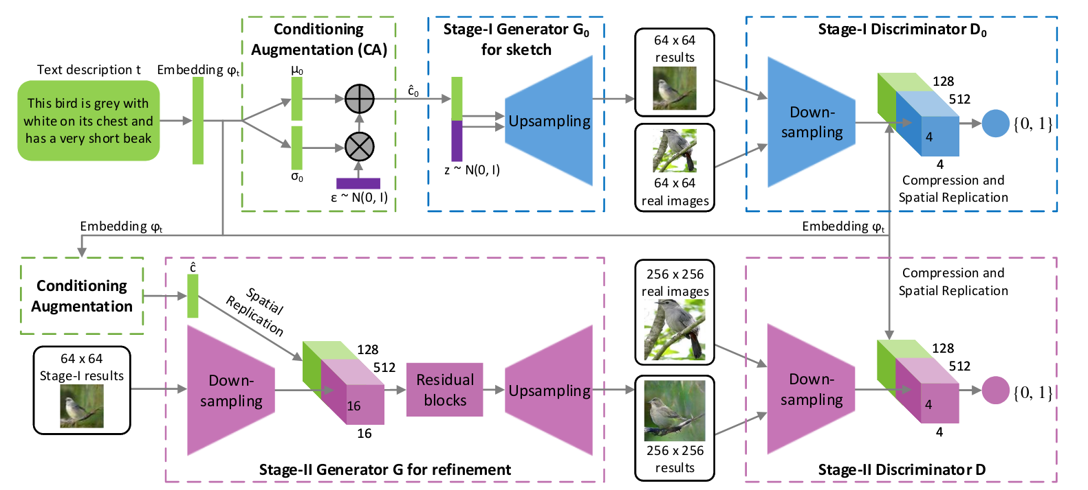
Image generation using StackGAN

Slide 13
Results
For our implementation MNIST dataset (of 60,000 images) was taken for image generations using GAN.
The model was run for 4000 epochs produces resultant images as follows:

Slide 14
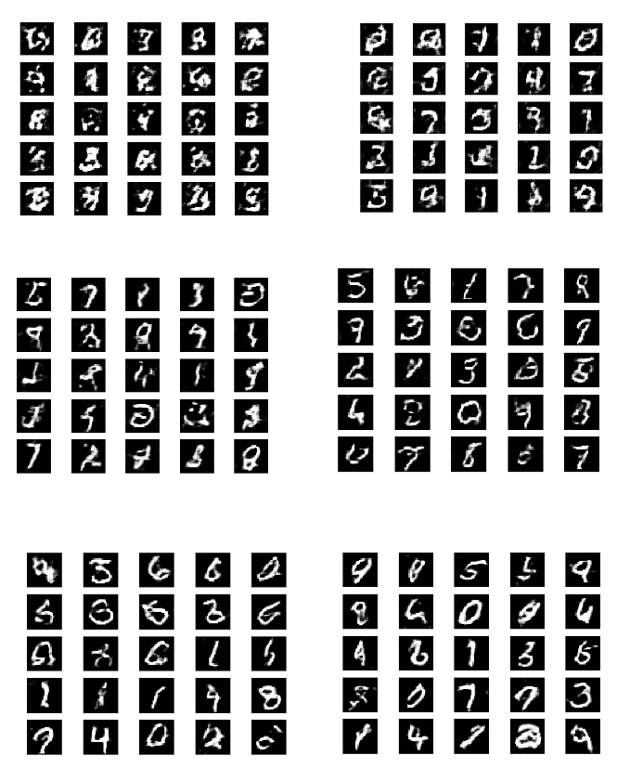

Slide 15
Future enhancements
Finding better loss functions, more stable training
Training generative models can useful to generate general features
The data can be generated from various formats like what the text to image we can also use speech to text and text to image or video,etc. appended to the same.
If proper hardware requirements are fulfilled, the stackGAN can be implemented which provides more stable images than single GAN.

Slide 16
Conclusion
Using deep convolutional generative adversarial network images that are similar to that present in MNIST dataset are produced similar approach can be used for generating similar images. This can help generating beautiful state-of-art samples.
StackGAN for producing images based on the text description can be implemented to find a way to convert one type of information to another(text to image synthesis).

Slide 17
References
Ian J. Goodfellow, Jean pouget-Abadie, Mehdi Mirza, Bing Xu, David Warde-Farley, Sherjil Ozair, Aaron Corville, Yoshua Bengio “Generative Adversarial Nets” in NIPS,2014
StackGAN : Text to photo-realistic Image Synthesis with stacked Generative Adversarial networks by Han Zhang, Tao Xu, Hongsheng Li, Shaoting Zhang, Xiaogang Wang, Xiaolei Huang, Dimitris Metaxas. 2017 IEEE International Conference on Computer Vision(ICCV)Documents of Stanford University’s CS231n “Generative Models”
Medium article by Jonathan Hui Article
Keras official documentation.

